Slide 1

Data Memory Access (8237A)
Computer Organization II – Project #2
Submitted By Group3
QMA!!!

Slide 2
Introduction
Notes:
Created a 32-bit version that works with AHB Bus using the AHB protocol.
Many of the included feature of the original 8237A are obsolete!
we decided to alter and enhance features for a better DMA.

Slide 3

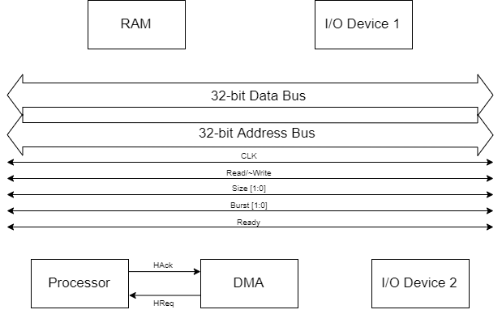
External Connections
Notes:
explain the bus signals

Slide 4
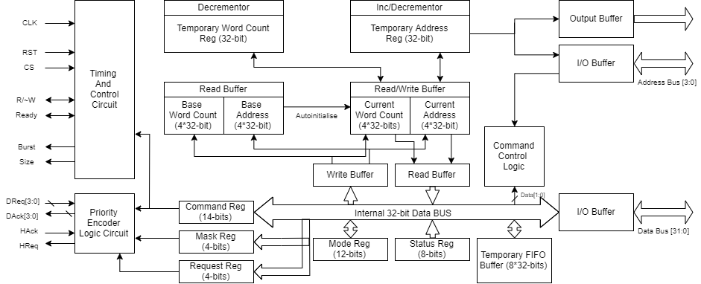
Internal Connections

Slide 5
Internal Connections (Cont.)
Command Register
Mode Register
Bit No: | Description:
1:0 | Transaction 1 beat size
3:2 | Transaction 1 Source Channel No.
5:4 | Transaction 1 Destination Channel No.
7:6 | Transaction 2 beat size
9:8 | Transaction 2 Source Channel No.
11:10 | Transaction 2 Destination Channel No.
12 | Controller Enable (1 = Tells the DMA to stop sending HReq until this Bit is Reset to 0)
13 | Rotating Polarity/ Fixed Polarity for other DMAs (1=Rotating, 0=Fixed)
Bit No: | Description:
0 | Autoinitialize Channel 0 Current Registers
1 | Channel 0 Address Decrement or Increment (0 = Increment, 1 = Decrement)
2 | Channel 0 Address Hold
3 | Autoinitialize Channel 1 Current Registers
4 | Channel 1 Address Decrement or Increment (0 = Increment, 1 = Decrement)
5 | Channel 1 Address Hold
6 | Autoinitialize Channel 2 Current Registers
7 | Channel 2 Address Decrement or Increment (0 = Increment, 1 = Decrement)
8 | Channel 2 Address Hold
9 | Autoinitialize Channel 3 Current Registers
10 | Channel 3 Address Decrement or Increment (0 = Increment, 1 = Decrement)
11 | Channel 3 Address Hold

Slide 6
Programming the DMA
Notes:
Similar to programming the 8237A but we added a Write All Mode Register instruction.

Slide 7
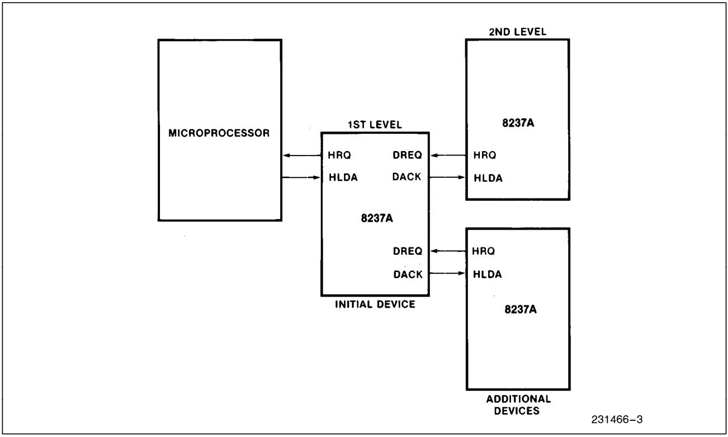
Some Design Choices
see also: Documentation
Notes:
explain the Cascade Optionality

Slide 8
Thank You!!

